Slide 1
Module: 1
The Concept of Time value of Money
Dr. Bidyadhar Padhi

Slide 2
Module-I
CO1: Understand the concept of economics, engineering economics and its application in engineering
Engineering Economics-its meaning and importance
Basic problems of an economy.
The concept of time value of money, Concept of Interest.
Time value of equivalence, Compound interest factors.
Cash flow diagrams,
Calculation of time value of equivalence,
Present worth comparison,
Future worth comparison,
Pay-back period comparison

Slide 3
Time value of Money
The Time Value of Money (TVM) is the idea that a certain amount of money today is worth more than the same amount in the future because of its earning potential.
In simple terms:
₹1000 today is better than ₹1000 one year later, because you can invest it now and earn interest, profit, or returns.
Money has a “time value” because it can grow over time if invested — and it can lose value due to inflation if just kept idle.
Why money today is more valuable:
Earning potential – You can invest today’s money to earn interest or returns.
Inflation – Over time, prices go up, reducing the buying power of future money.
Risk & uncertainty – There’s always a risk that you might not receive future money.
Opportunity cost – Delaying money means missing other profitable opportunities.

Slide 4
Time Value of Money
Money has time value
Money value differs from one point of time to another
Money has time value because of two important reasons:
Earning power of money
Purchasing power of money

Slide 5
Earning power of Money
Meaning: Earning power refers to the capacity of money (or an investment) to generate income or returns over time.
It is related to the productivity of money. If you invest ₹1,00,000 in a business, fixed deposit, or shares, the returns you get (interest, profit, dividend, rent, etc.) reflect the earning power of that money.
Example: If you invest ₹1,00,000 in a bank FD at 6% annual interest, your earning power is ₹6,000 per year.
It focuses on how much money can grow or generate more money.

Slide 6
Purchasing Power of Money
Meaning: Purchasing power refers to the ability of money to buy goods and services. It depends on the value of money and the level of prices in the economy.
If prices rise (inflation), the purchasing power of money falls
If prices fall (deflation), the purchasing power of money increases.
For Example if You have only RS 100 and You cane buy
It focuses on the value of money in terms of goods and services it can buy.
Suppose you an income of Rs. 100 and you want to purchase rice
Price | Qty
20 | 5kg
10 | 10 Kg
25 | 5 Kg.

Slide 7
Difference between Earning Power and Purchasing Power of Money
Basis | Earning Power of Money | Purchasing Power of Money
Meaning | Ability of money to generate income/returns. | Ability of money to buy goods and services.
Focus | Growth of money (future income). | Value of money (present buying capacity).
Depends on | Rate of return, investment opportunities, productivity. | Price level, inflation/deflation, cost of living.
Example | ₹1,00,000 in FD at 6% earns ₹6,000 yearly. | ₹500 could buy 10 kg rice earlier, now only 5 kg due to inflation.
Nature | Related to income and wealth creation. | Related to real value of money in the market.

Slide 8
Interest
What is interest?
Interest is manifestation of time value of money.
It is the amount we owe using some ones else’s money.
In other words it is the amount some one pays for using your money

Slide 9
Why interest are charged?
Money has time value
Interest is charged by the lender for risk of non payment
is a price for sacrifice of present consumption and waiting.
From the borrower's point of view interest is given because a loan is both an obligation and opportunity

Slide 10
Concept of Interest
Interest can be calculated in two ways:
Simple Interest
Compound Interest
Simple Interest: In case of simple interest, interest earned is directly proportional to the capital involved in loan. Simple interest is earned on the beginning principal.
Simple Interest: I = P i N
P = Present amount or principal amount
i = Interest Rate
N = Number of interest period.
F = P+I
F= P + PiN
F= P(1+iN)
F= Future amount
Ex: P =100 i = 10% N=2
F = 100[ 1 + (0.10 × 2) ]= 120

Slide 11
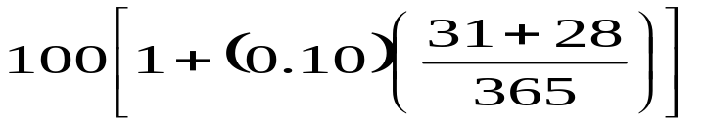
When N is not a full year, there are two ways to calculate simple interest earned during the period of the load
When ordinary simple interest is used , the year is divided in to twelve 30 day periods
In exact simple interest, a year has precisely the calendar number of days, and N is the fraction of the number of days the loan is in effect that year
Example: P =100 i= 10% N= 2months (January, Feb)
Ordinary Simple interest :
F = 100 [1 + (0.10 × 2/12)]
Exact Simple interest: F =

Slide 12
Compound Interest
It is good to receive compound interest, but not so good to pay.
interest is calculated not only on the beginning principal, but on any interest accumulated in the mean time
Example : P= 100 i = 10% N = 2
 | At the beginning of the year | At the end of year 1 | At the end of year 2
Simple Interest | 100 | 110 | 120
Compound interest | 100 | 110 | 121

Slide 13




Compound interest Formula
Compound Amount due in two years = Amount borrowed + 1st year Interest + 2nd year interest
2nd Year Interest = (Amount borrowed + 1st year Interest) Rate of Interest

Slide 14
Nominal Interest rate
Generally interest rates are quoted on annual basis. But sometimes interest rates may be compounded number of times, like monthly, quarterly and semi-annually
For an example if the amount is compounded semi-annually there will be two compounding period. With interest rate of 5% for each half is typically called 10% compounded semi-annually
The nominal interest rate is base rate without the compounding effect.
Example: P =1000 i = 12 %

Slide 15
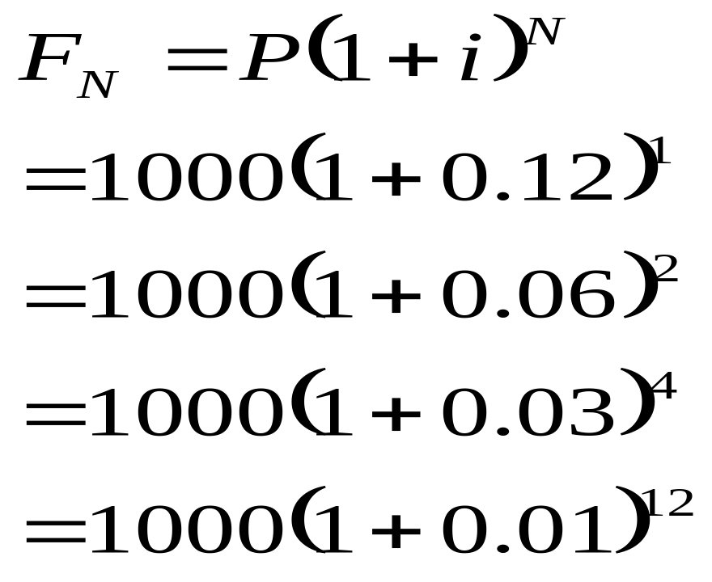

Slide 16
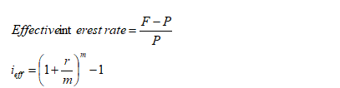

Effective Interest Rate
The effective annual interest rate is simply the ratio of the interest charged for 1 year to the principal.
In other words effective interest rate is the rate of interest which include the compounding effect of interest on interest

Slide 17
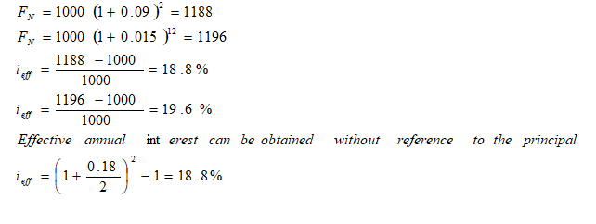

Slide 18
Time- Value Equivalence
End of Year | Receipt from A (Rs) | Receipt from B (Rs.)
0 | 12,500
1 |  | 2000
2 | - | 2000
3 |  | 2000
4 | - | 2000
5 |  | 2000
6 | - | 2000
7 | - | 2000
8 | - | 2000
9 | - | 2000
10 | - | 2000
Total | 12,500 | 20,000

Slide 19
Time value of Equivalence
If two and more situations are to be compared their characteristics must be placed on an equivalent basis. Which is worth more, 4 kg of product A or 500 gms of product . To answer this question, it is necessary to place the two amounts on an equivalent basis by use of the proper conversion factor. After conversion of kg to grams, the question becomes, which is worth more, 4 kg of product A or 500 gms of product
Two things are said to be equivalent when they have the same effect.
Three elements are involved in the equivalence of series of money. These are
The amounts of the sums
The times of occurrence of the sums and
The interest rate

Slide 20
In the above example we can compare both the option by braining them to a common base.
Either we can convert the single value to series of values
12500(A/P,10,10)=2034.75
Or we can convert series of values to single value
Series can be compared with series
2000 (P/A,10,10)= 12289.14
Single present value can be compared with single present value
Single future values can be compared with single future values

Slide 21
Compound-Interest Factors
There are 7 conversion factors. They are called as compound-interest factors. Some conversion factors help us in converting single value to single value and some conversion factors help in converting single value to series of values. Those 7 factors are
single value to single value
Compound amount Factor: F/P
Present Worth factor: P/F
Uniform Series
Capital Recovery Factor :A/P
Present worth Factor : P/A
Sinking Fund Factor : A/F
Compounding Factor : F/A
Gradient Facotor : A/G

